Slide 1
PRESENTING
BY
MANOHAR ANDE
NBHTRNO4

Slide 2
AGENDA:
WHAT IS CLASS
WHAT IS OBJECT
REALWORLD EXAMPLE

Slide 3
CLASS:
A class is like to design /blue print to create an object
A class consists of variables and methods
OBJECTS:
An instance of a class we can create any number of objects.

Slide 4
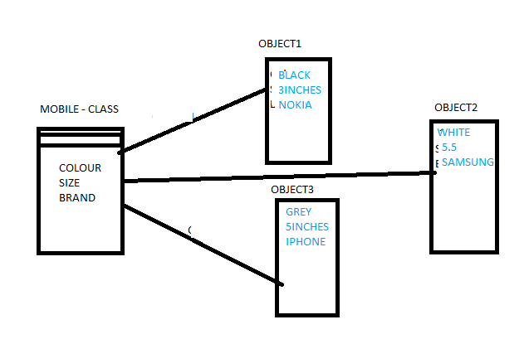



EXAMPLE:

Slide 5
THANK YOU

